Slide 1

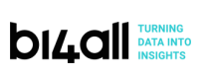

Title
Human Resources Analysis Predict Attrition
Ana Filipa Gonçalves, 20222157
Cláudia Gomes, 20221615
Frederico Rodrigues, 20222159
João Silva, 20222190

Slide 2
Agenda
Executive Summary
Context
Model
Analysis
Suggestions

Slide 3
Executive Summary (1/2)
Attrition, which represents the turnover of employees across all departments and levels of an organization, has several downsides and negative impacts
These effects can be significant and wide-ranging, affecting the company's performance and its ability to achieve its strategic objectives
Some of the key disadvantages of having a high attrition rate in a company include the cost of recruitment and onboarding, loss of knowledge and expertise, productivity disruption, decreased team cohesion, impact on customer relationships, delayed project and goals, amongst many others
Predictive analytics allows HR to take the best decisions that reduce attrition rate
Make decisions based on statistical data rather than speculation to address real turnover drivers
Identify systemic issues affecting engagement and attrition, facilitating company-wide adjustments rather than individual-level changes
To address this issue in your company, a predictive analytics model was developed to identify potential employee attrition
The Random Forest model emerged as the most effective, balancing accuracy and interpretability
The confusion matrix shows a significant number of true positives and true negatives, with very few false positives and false negatives, reflecting the model's reliability
The most important features resulted in the model are monthly income, overtime, age and years at the company

Slide 4
Executive Summary (2/2)
Regarding the predictive model, who’s really leaving your Company?
Younger employees are more likely to leave the company than others
Single employees are more likely to quit their jobs in comparison to married or divorced employees, boosting an attrition rate of 26%, while married and divorced employees boost 12% and 10%, respectively
Sales representatives have the highest attrition rate, followed by Laboratory Technicians, Human Resources (23%) and Sales Executives (17%). All of these are well above your average attrition rate of 16%
Employees who work overtime have a higher attrition rate (31%) in comparison to those who don’t work overtime (10%)
The employees who leave the company have a significantly lower monthly income than those who don’t leave
Employees who live closer to their work places are less likely to quit their jobs
Employees who travel the most for work, also have higher attrition levels
New employees are more likely to quit their jobs, when comparing to employees that have been working in the company for more than a couple of years. This trend is particularly steeper in the first 2 years working in the company
Therefore, we suggest three strategic priorities to reduce attrition rate
For employee profile, it is important to implement mentorship and career development programs; promote a culture of ongoing learning; provide career advancement opportunities to retain experienced workers and act preventively before they reach the average age of leaving; conducting regular satisfaction surveys
Regarding monthly income feature, we recommend salaries according to the industry benchmarks; improve Incentives and bonuses; implement clear career planning and salary revision, as well as retirement savings account
Regarding the work life balance, it is important to implement flexible work hours and support effective remote work; hire additional staff and redistribute workloads among employees; establish a predetermined high rate of pay for overtime work; provide transportation assistance and create new satellite offices near employee housing clusters

Slide 5
Objectives of this project
1
Build a classification model to predict the Attrition probability and the final classification given by the model
Find the features that most influence the attrition rate
Make recommendations in actions in order to reduce the attrition rate
Integrate the predictive attrition model into a Human Resource Dashboard for real-time tracking and monitoring employees predicted at risk of attrition.
2
3
4

Slide 6
Agenda
Executive Summary
Context
Model
Analysis
Suggestions

Slide 7
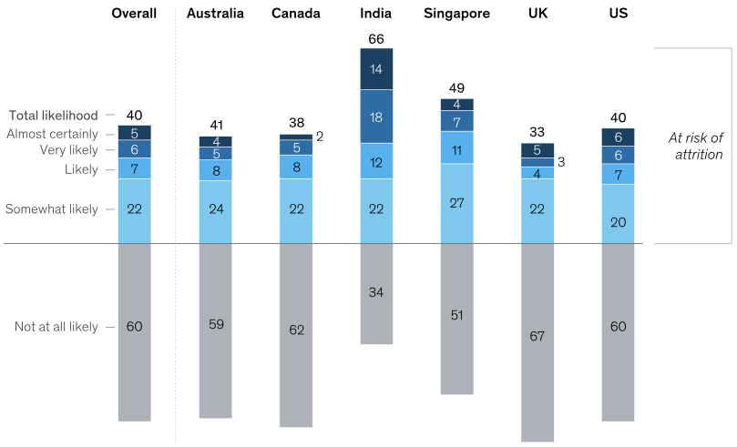
Is the Talent Crisis Global? 82% of Top Executives Say Yes!
According to McKinsey latest reports about Companies’s Attrition:
40% of workers globaly are considering leaving their jobs
Almost one-third of senior leaders cite finding talent as their most significant managerial challenge
82% of Fortune 500 executives belive their companies are failling to recruit highly talented individuals
A majority of people who quit their jobs are not returning to the industries they left, showing a significant level of industry-hopping

Slide 8
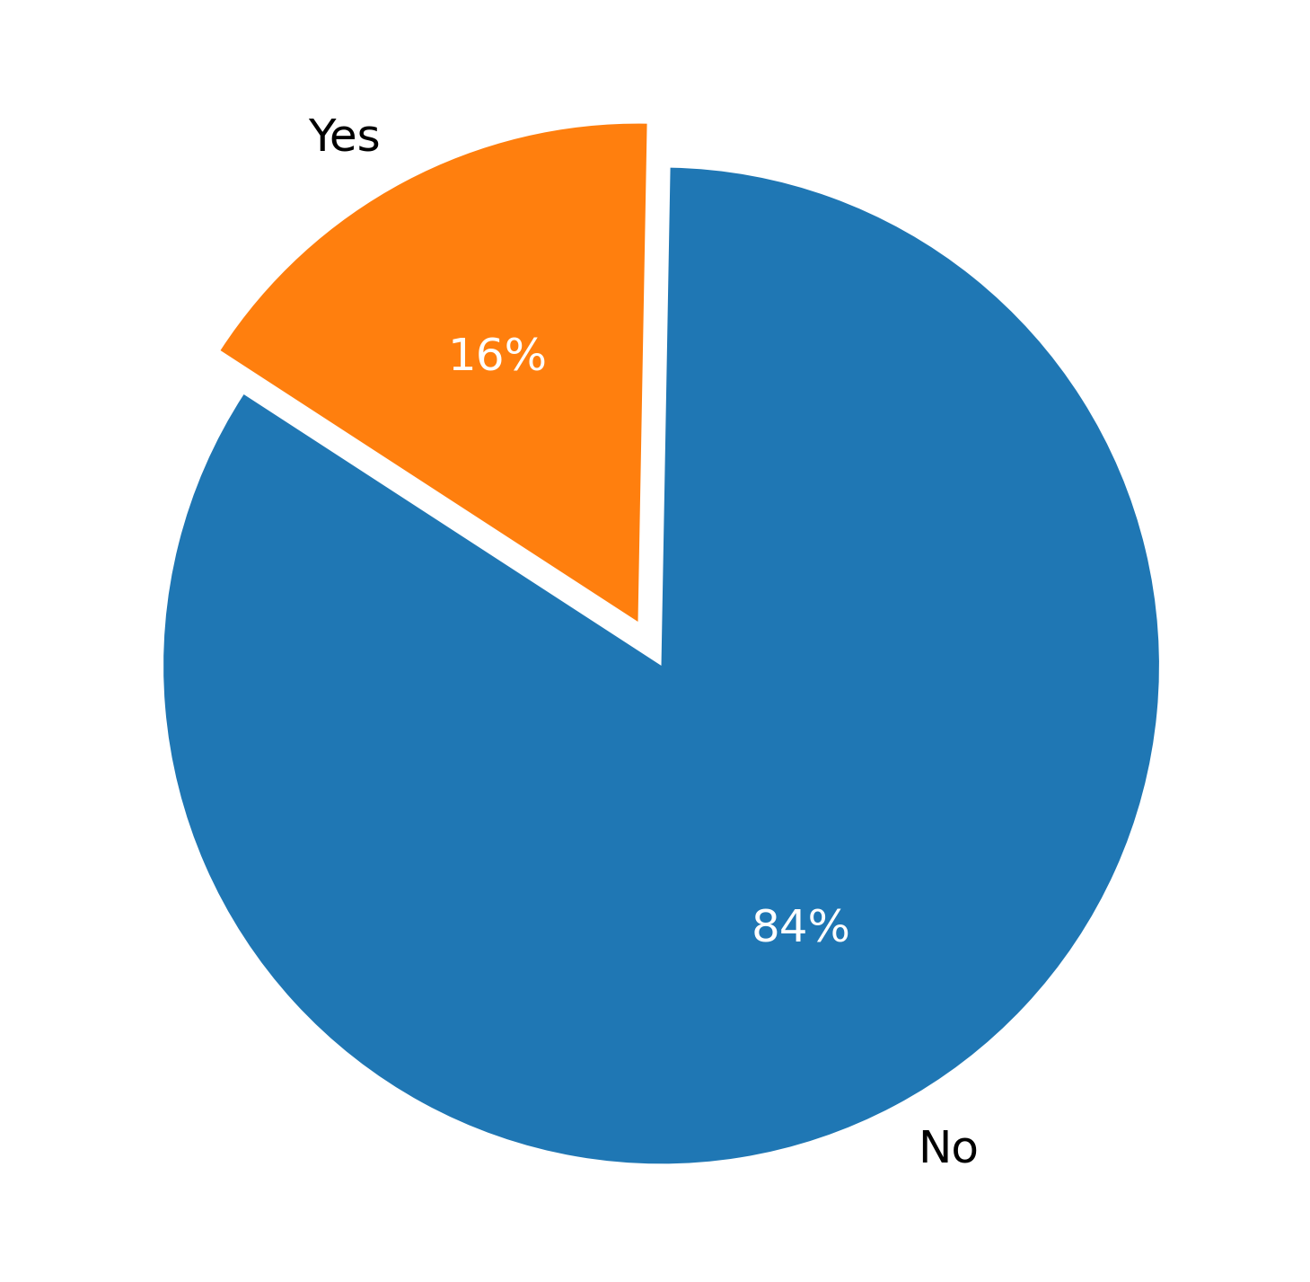
How to approach this issue? Predictive analytics allows HR to take the best decisions that reduce attrition rate
“We find that statistical data is much more effective and actionable than perception analysis, because there's all sorts of bias in asking people questions,” - Matthew Stevenson, partner and co-leader of Mercer’s Workforce Strategy & Analytics group
Your Company’s Attrition Rate
Key benefits:
Data-informed Engagement Strategies
Improved Retention
Orgazinational Change

Slide 9
Agenda
Executive Summary
Context
Model
Analysis
Suggestions

Slide 10
Getting started with our model
Objective: Develop a predictive analytics model to identify potential employee attrition, enabling proactive retention strategies
Background: High attrition rates impact productivity and incur significant costs Understanding key factors driving attrition can help in formulating effective retention policies
Data Source: Utilized your company’s dataset from HR, containing a wide range of employee attributes
Tools and Technologies:
Data Processing: Python, Pandas for data manipulation
Model Development: Scikit-learn for machine learning algorithms
Handling Class Imbalance: Imbalanced-Learn library
Visualization: Matplotlib and Seaborn for graphical representation of data insights

Slide 11
Methodology and Key Insights separated in 4 steps
Data Preprocessing:
Cleaned and transformed the dataset, setting 'EmployeeNumber' as a unique identifier.
Converted categorical variables (e.g., 'BusinessTravel', 'Department') into numerical formats using label encoding for model compatibility.
Target Variable Analysis:
Transformed 'Attrition' into a binary format for predictive modeling.
Analyzed target distribution, addressing class imbalance through Random OverSampling for unbiased model training.
Feature Engineering:
Identified and excluded less relevant features (e.g., 'Over18', 'StandardHours') to enhance model focus on impactful variables.
Employed feature importance analysis to highlight top factors influencing attrition, like 'OverTime' and 'JobRole'.
Model Selection and Evaluation:
Explored various models including Logistic Regression, Random Forest, and Decision Tree Classifier.
Fine-tuned models using GridSearchCV for optimal performance.
Evaluated models based on accuracy, precision, recall, F1 score, and ROC-AUC metrics.

Slide 12
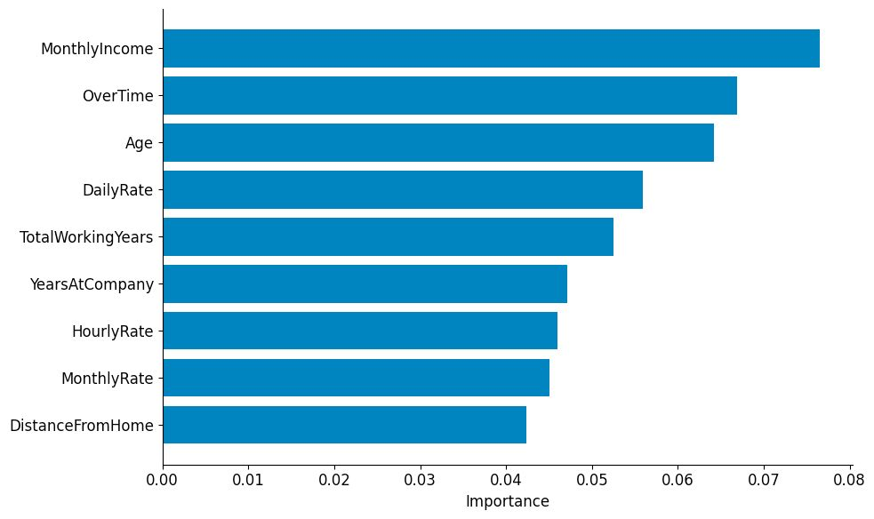
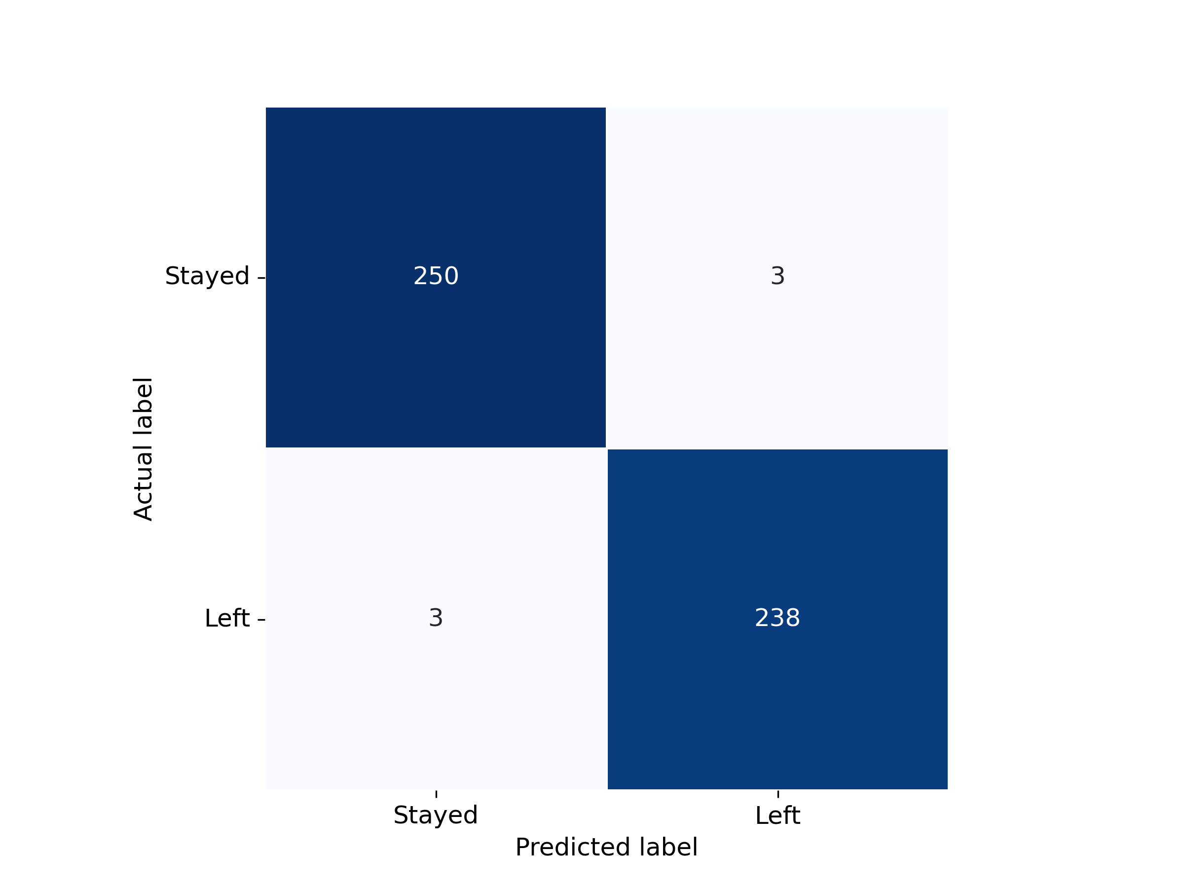
A Glimpse into Model Performance
Model Findings
The Random Forest model emerged as the most effective, balancing accuracy and interpretability.
High-Level Summary
Model Accuracy
Our model achieves a high accuracy rate, indicating a strong alignment between predicted outcomes and actual data.
The confusion matrix shows a significant number of true positives and true negatives, with very few false positives and false negatives, reflecting the model's reliability.
Our predictive model showcases excellent performance in forecasting employee turnover. It serves as a strategic tool for pre-empting attrition and crafting retention strategies.
Each row of the matrix represents the instances in an actual class while each column represents the instances in a predicted class, or vice versa

Slide 13
Agenda
Executive Summary
Context
Model
Analysis
Suggestions

Slide 14
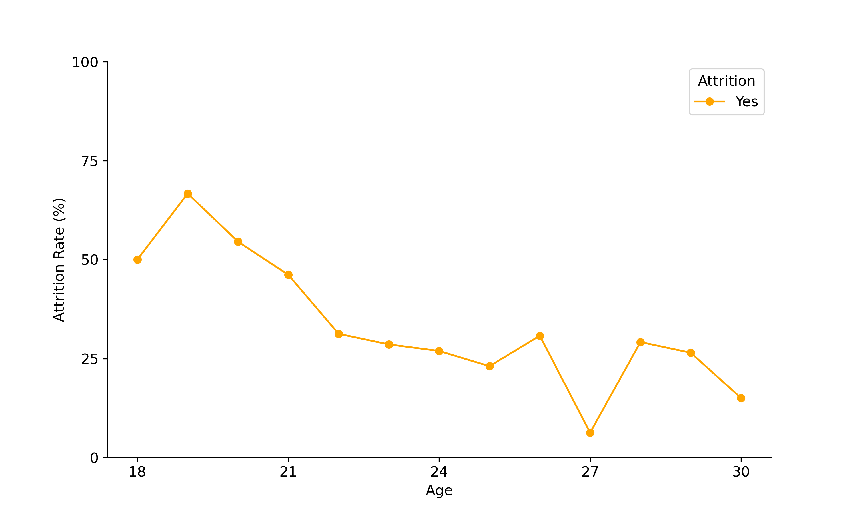
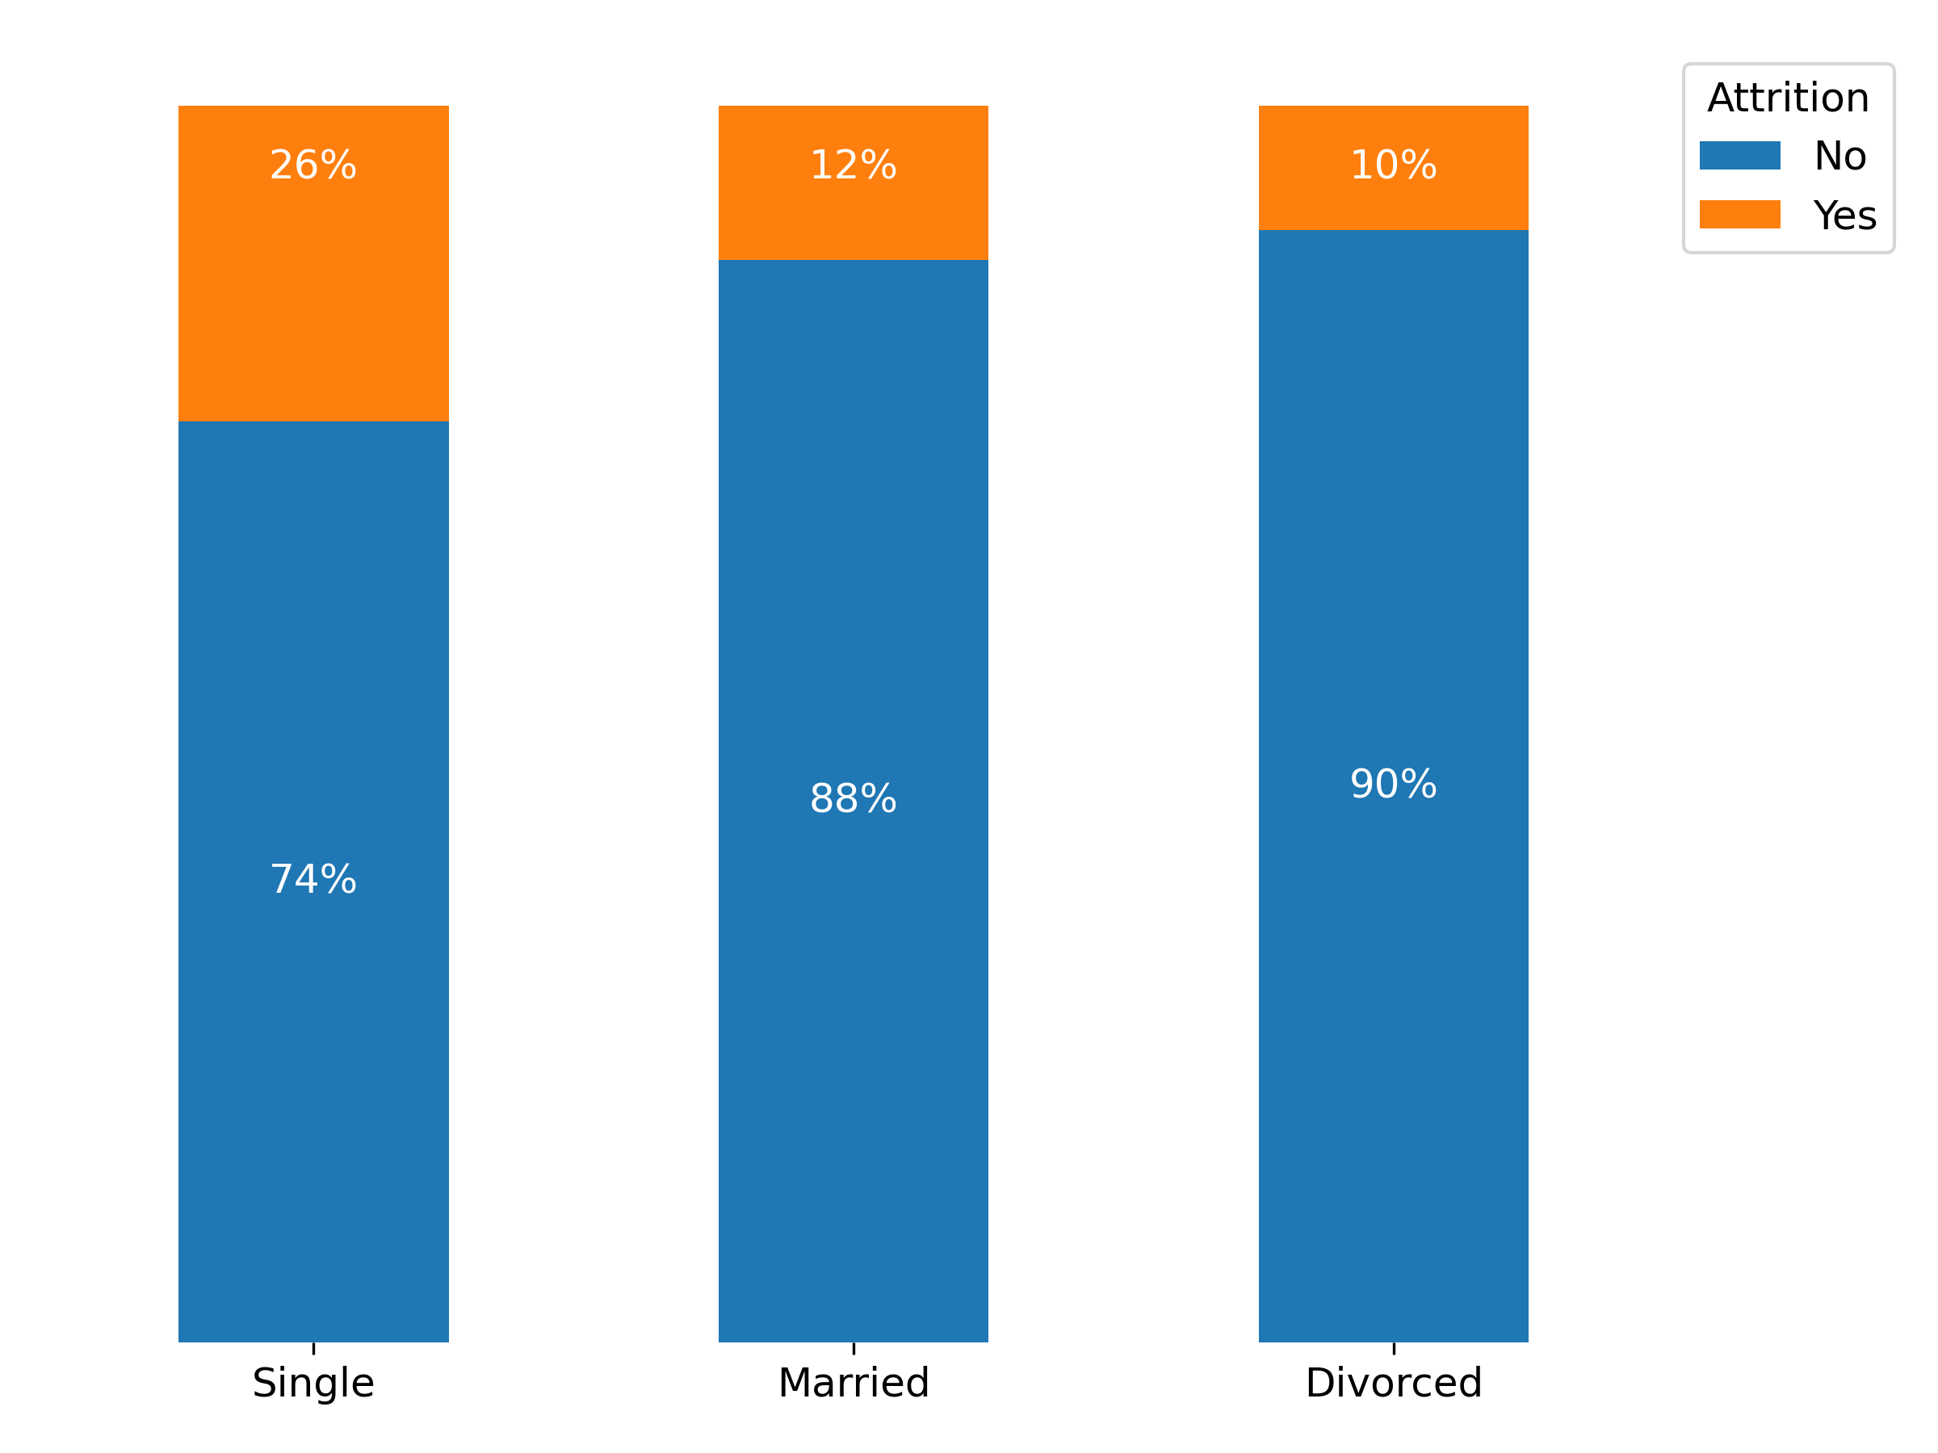
Who's Really Leaving Your Company? Younger and single employees
Younger employees are more likely to leave the company than others.
Single employees are more likely to quit their jobs in comparison to married or divorced employees, boosting an attrition rate of 26%, while married and divorced employees boost 12% and 10%, respectively.
We can actually see that between the ages of 18 and 21, we are losing more employees than those retained.

Slide 15

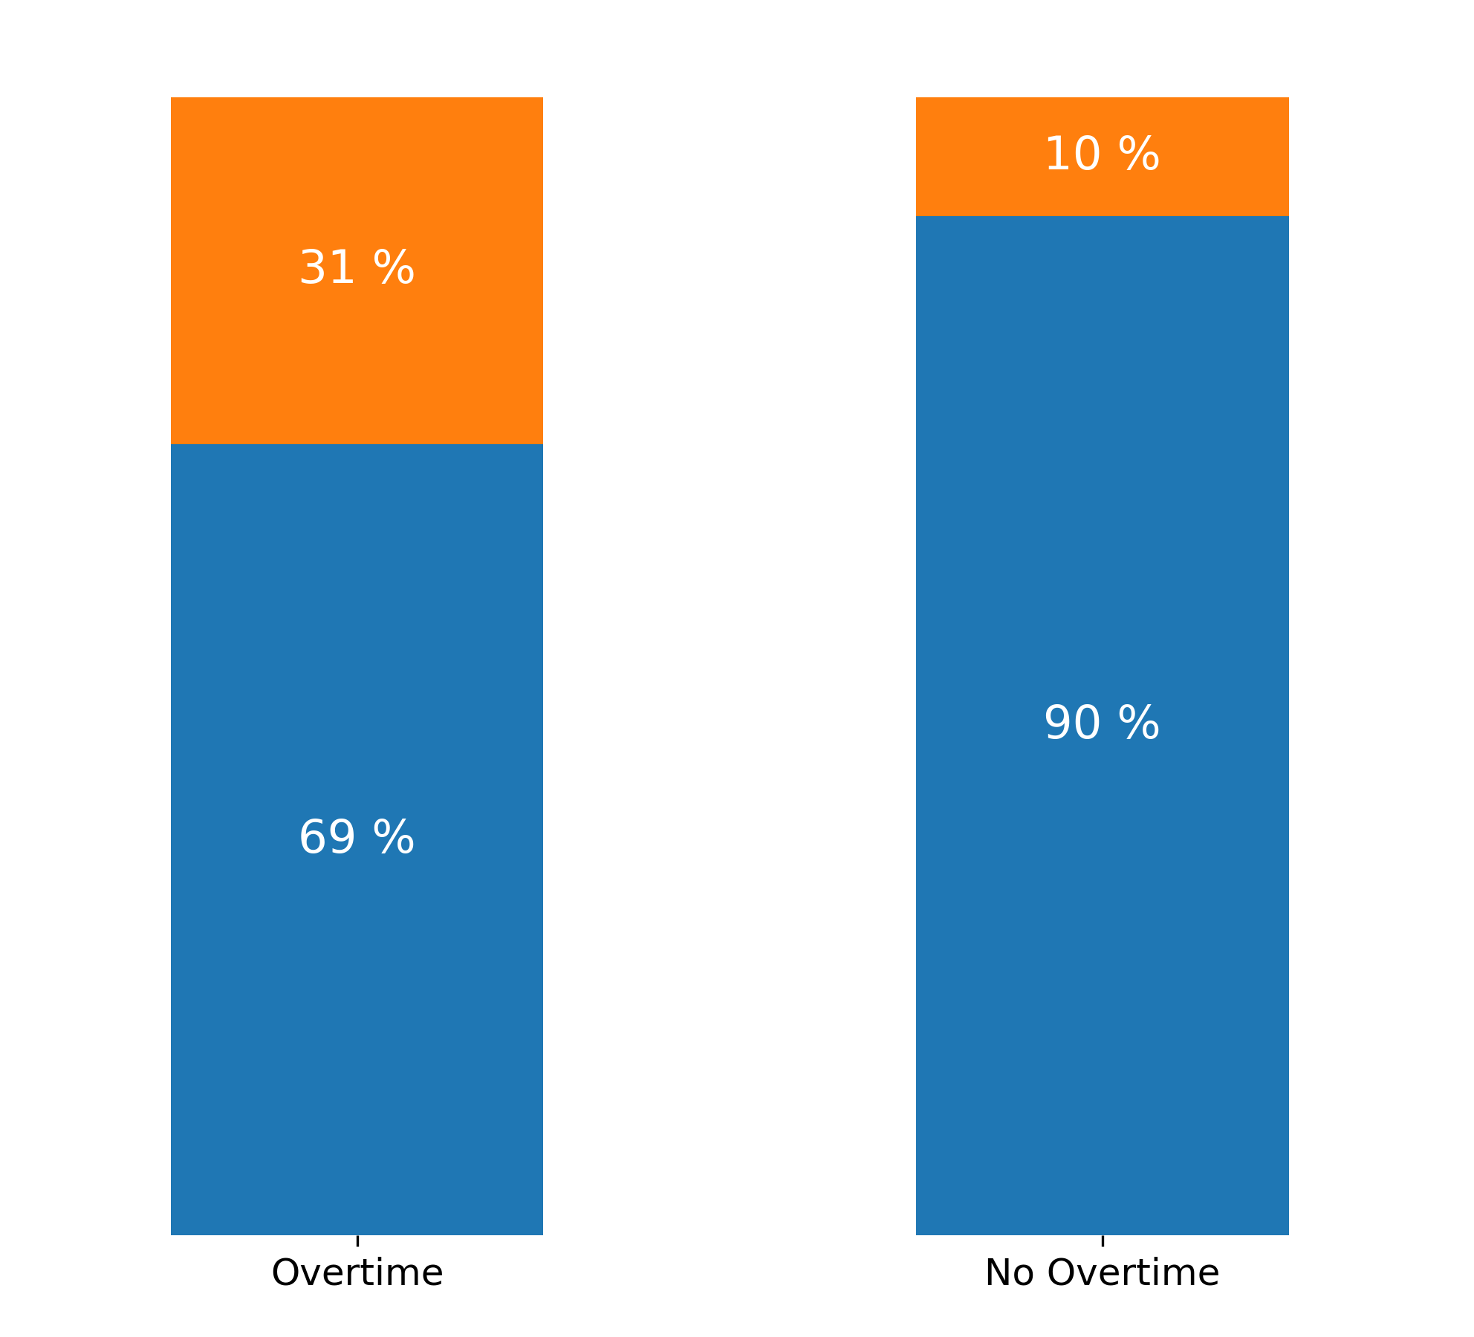
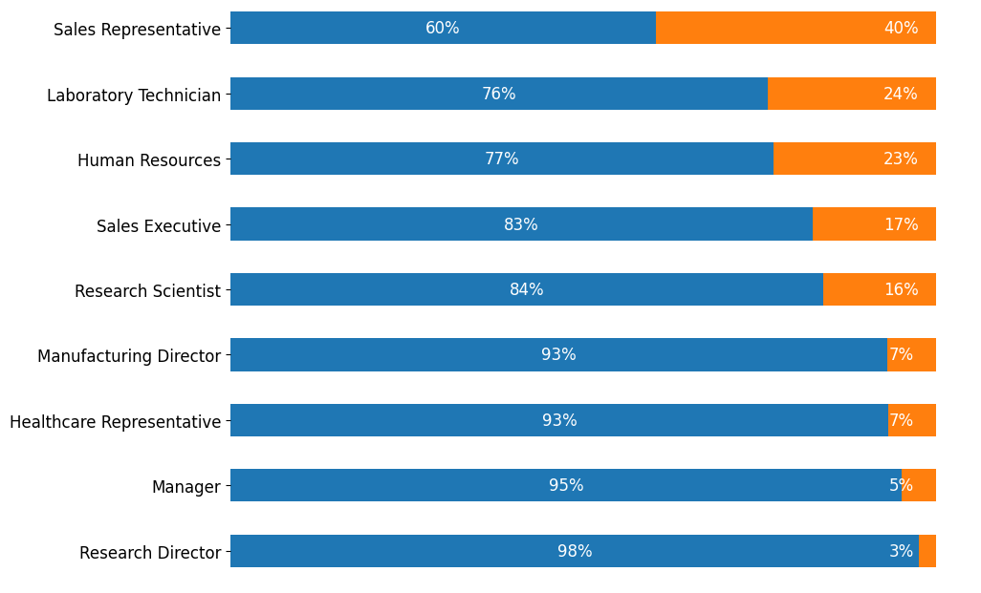
Who's Really Leaving Your Company? Sales Representatives, Lab Technicians, HR and Sales Executives, plus Employees with Overtime
Sales representatives have the highest attrition rate (40%), followed by Laboratory Technicians (24%), Human Resources (23%) and Sales Executives (17%). All of these are well above your average attrition rate of 16%.
Overtime is also directly related to higher attrition rates. Employees who work overtime have a higher attrition rate (31%) in comparison to those who don’t work overtime (10%).
40%
31%
of Sales Representatives quit their jobs
of attrition for employees who work overtime, a three times higher rate than those we don’t work overtime.
24%
of Laboratory Technicians quit their jobs

Slide 16
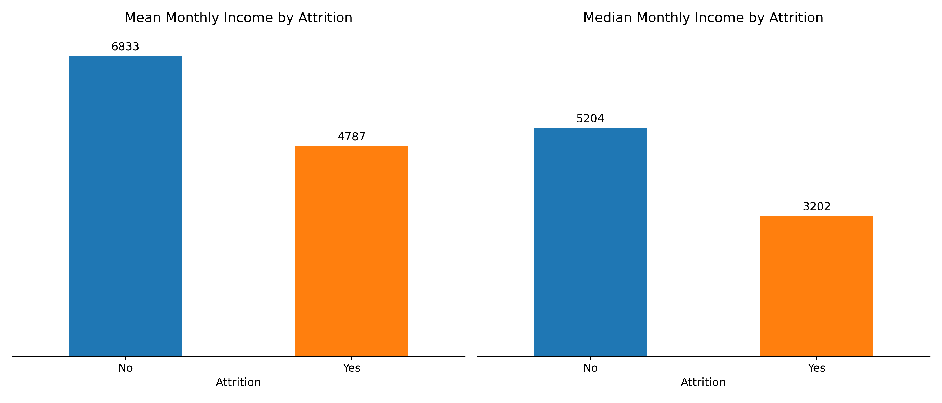
Who's Really Leaving Your Company? Employees with lower salary
Your data also shows that those who leave the company have a significantly lower monthly income than those who don’t leave. This reinforces the importance of competitive compensation in retaining talent.

Slide 17
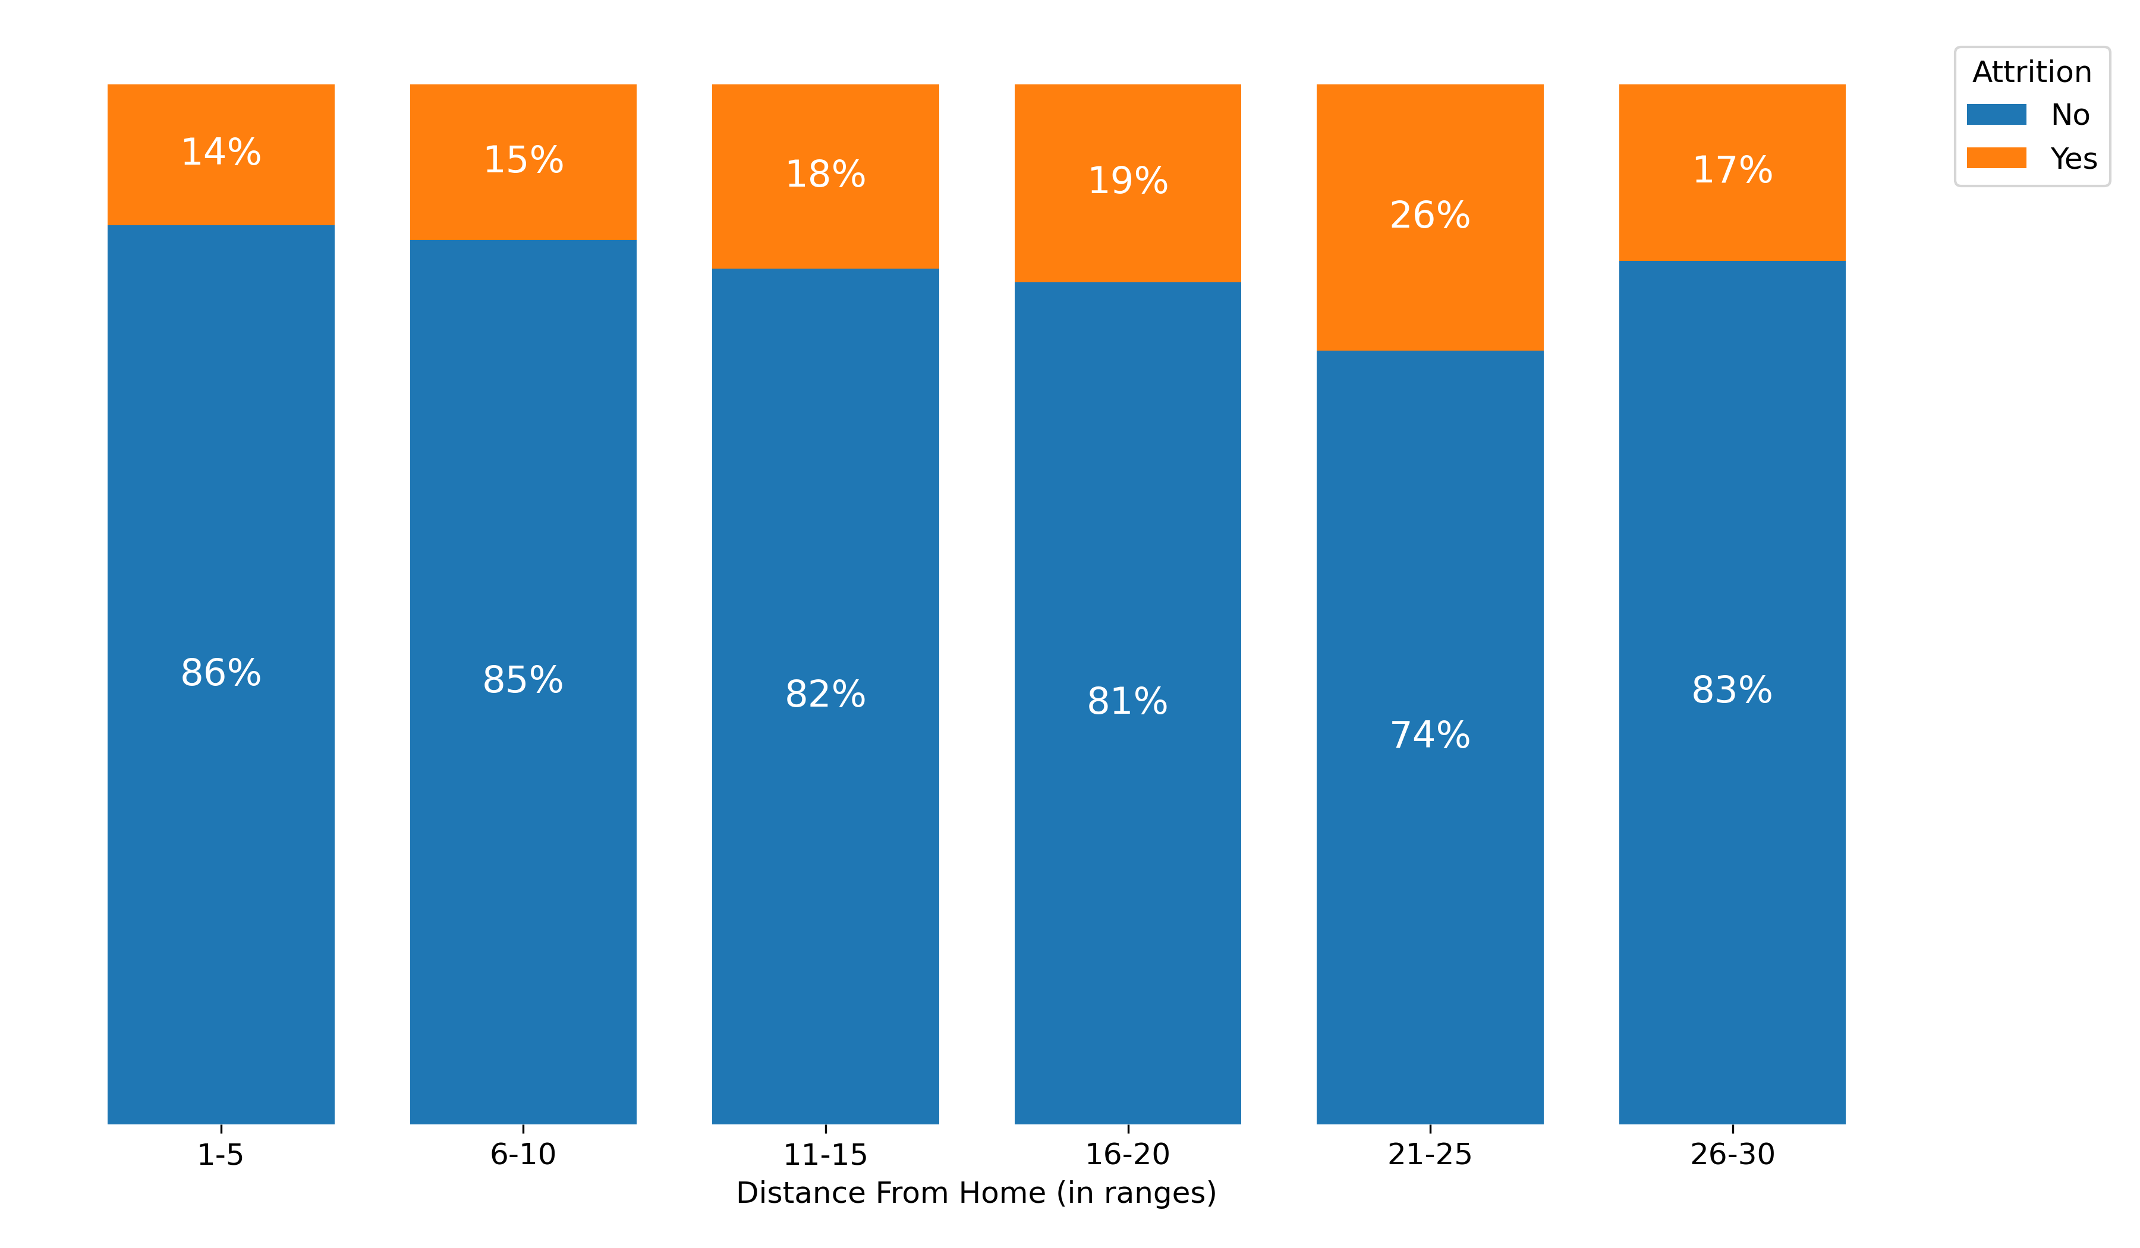
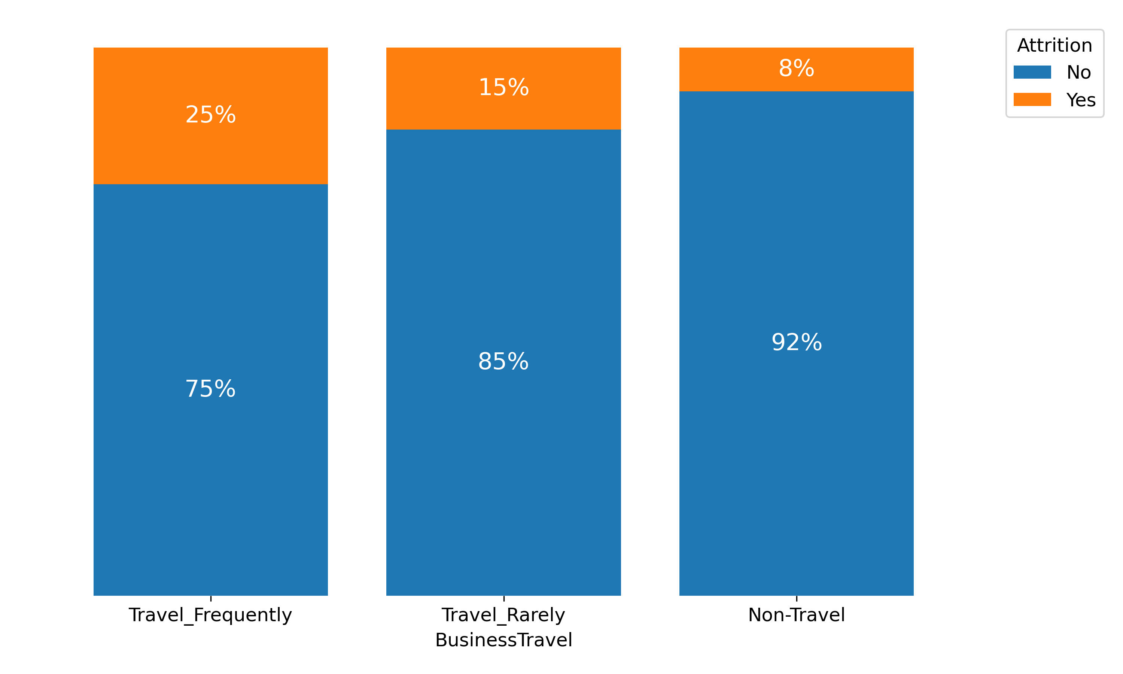
Who's Really Leaving Your Company? Employees who live far from the office and travelling for work frequently
As distance from home increases, the attrition rate also goes up. There’s a clear uptrend until the 21-25 range, meaning that employees who live closer to their work places are less likely to quit their jobs.
Employees who travel the most for work, also have higher attrition levels. Those who rarely travel have intermediate attrition rates, and those who don’t travel at all have the lowest attrition rates.
26%
Attrition rate for employees leaving between 21-25 away from the office
3.1x
Higher attrition for employees who travel frequently for work

Slide 18
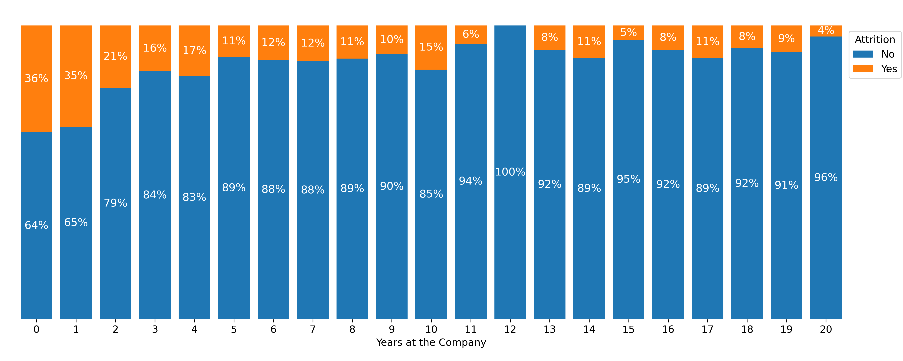
Who's Really Leaving Your Company? Employees with less than 2 Years’ Service
New employees are more likely to quit their jobs, when comparing to employees that have been working in the company for more than a couple of years. This trend is particularly steeper in the first 2 years working in the company, with attrition rates over 20% before levelling off after 5 years of service
-2 Years
of your employees quit their jobs before completing 2 years working in the company

Slide 19
Agenda
Executive Summary
Context
Model
Analysis
Suggestions

Slide 20



Three strategic priorities to reduce attrition rate
Dissatisfaction strongly expressed in young and single employees
Income inequality strongly marked dissatisfaction, specially among the lowest paid workers
Monthly Income
Work-life
Balance
Overtime can lead to burnout and dissatisfaction, specially in employees that work away from home
Employee
Profile
Issues
Implement mentorship and career development programs
Act preventively before they reach the average age of leaving, conducting regular satisfaction surveys
Promote a culture of ongoing learning
Provide career advancement opportunities to retain experienced workers
Years of Service Incentives
Salaries according to the industry benchmarks
Medical Insurance and Education incentives
Improve Incentives and Bonuses
Clear Career Planning and Salary Revision
Retirement Savings Account
Establish a predetermined high rate of pay for overtime work
Implement flexible work hours and support effective remote work
Hire additional staff and redistribute workloads among employees
Satellite offices near employee housing clusters
Conduct regular exit surveys
Provide transportation assistance
Suggestions

Slide 21
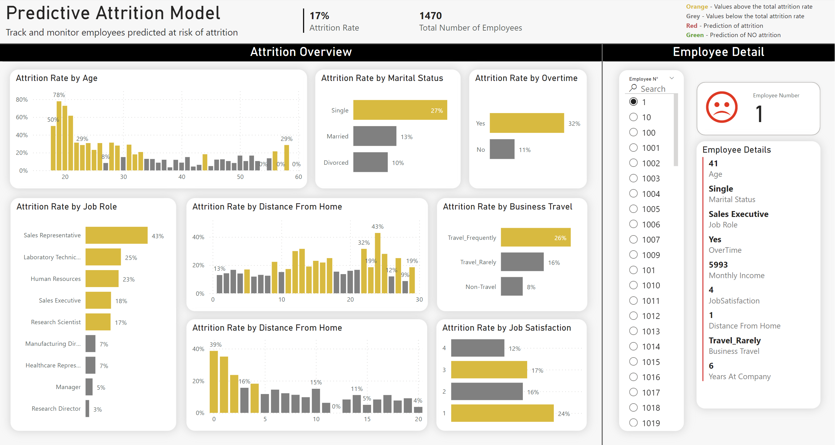
Integrating Predictive Attrition Model into HR Dashboard
Empower HR with actionable insights to proactively address potential employee attrition.
Real-Time Monitoring: Track and monitor employees predicted at risk of attrition.
Prioritization: Focus on high-risk individuals for retention interventions.
Trends & Analysis: Visualize attrition patterns over time to inform strategic HR decisions.
Custom Alerts: Set notifications for flagged employees to take timely action.

Slide 22
The End
Questions?

Slide 23
The End
Annexes

Slide 24
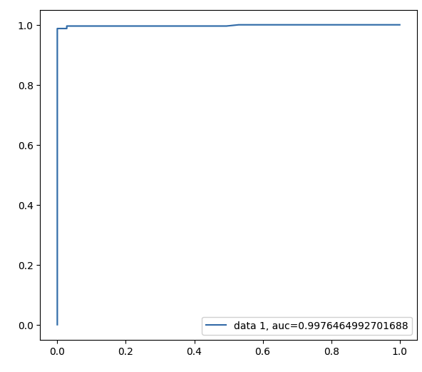
A Glimpse into Model Performance
Crucial Metrics Explained:
Accuracy: Reflects the proportion of total correct predictions, crucial for overall reliability.
Precision: Measures the exactness of the model in predicting attrition, crucial for resource allocation in retention programs.
Recall: Assesses the model's ability to capture actual attrition cases, vital for comprehensive intervention strategies.
F1 Score: Balances precision and recall, providing a singular metric for model performance in uneven class distributions, typical in attrition datasets.
Our Model Results
Metric | Score
Accuracy | 0.99
Precision | 0.99
Recall | 0.99
F1 Score | 0.99
ROC curve, or Receiver Operating Characteristic curve, is a graphical plot that illustrates the diagnostic ability of a binary classifier system as its discrimination threshold is varied, by plotting the true positive rate against the false positive rate at various threshold settings.

Slide 25
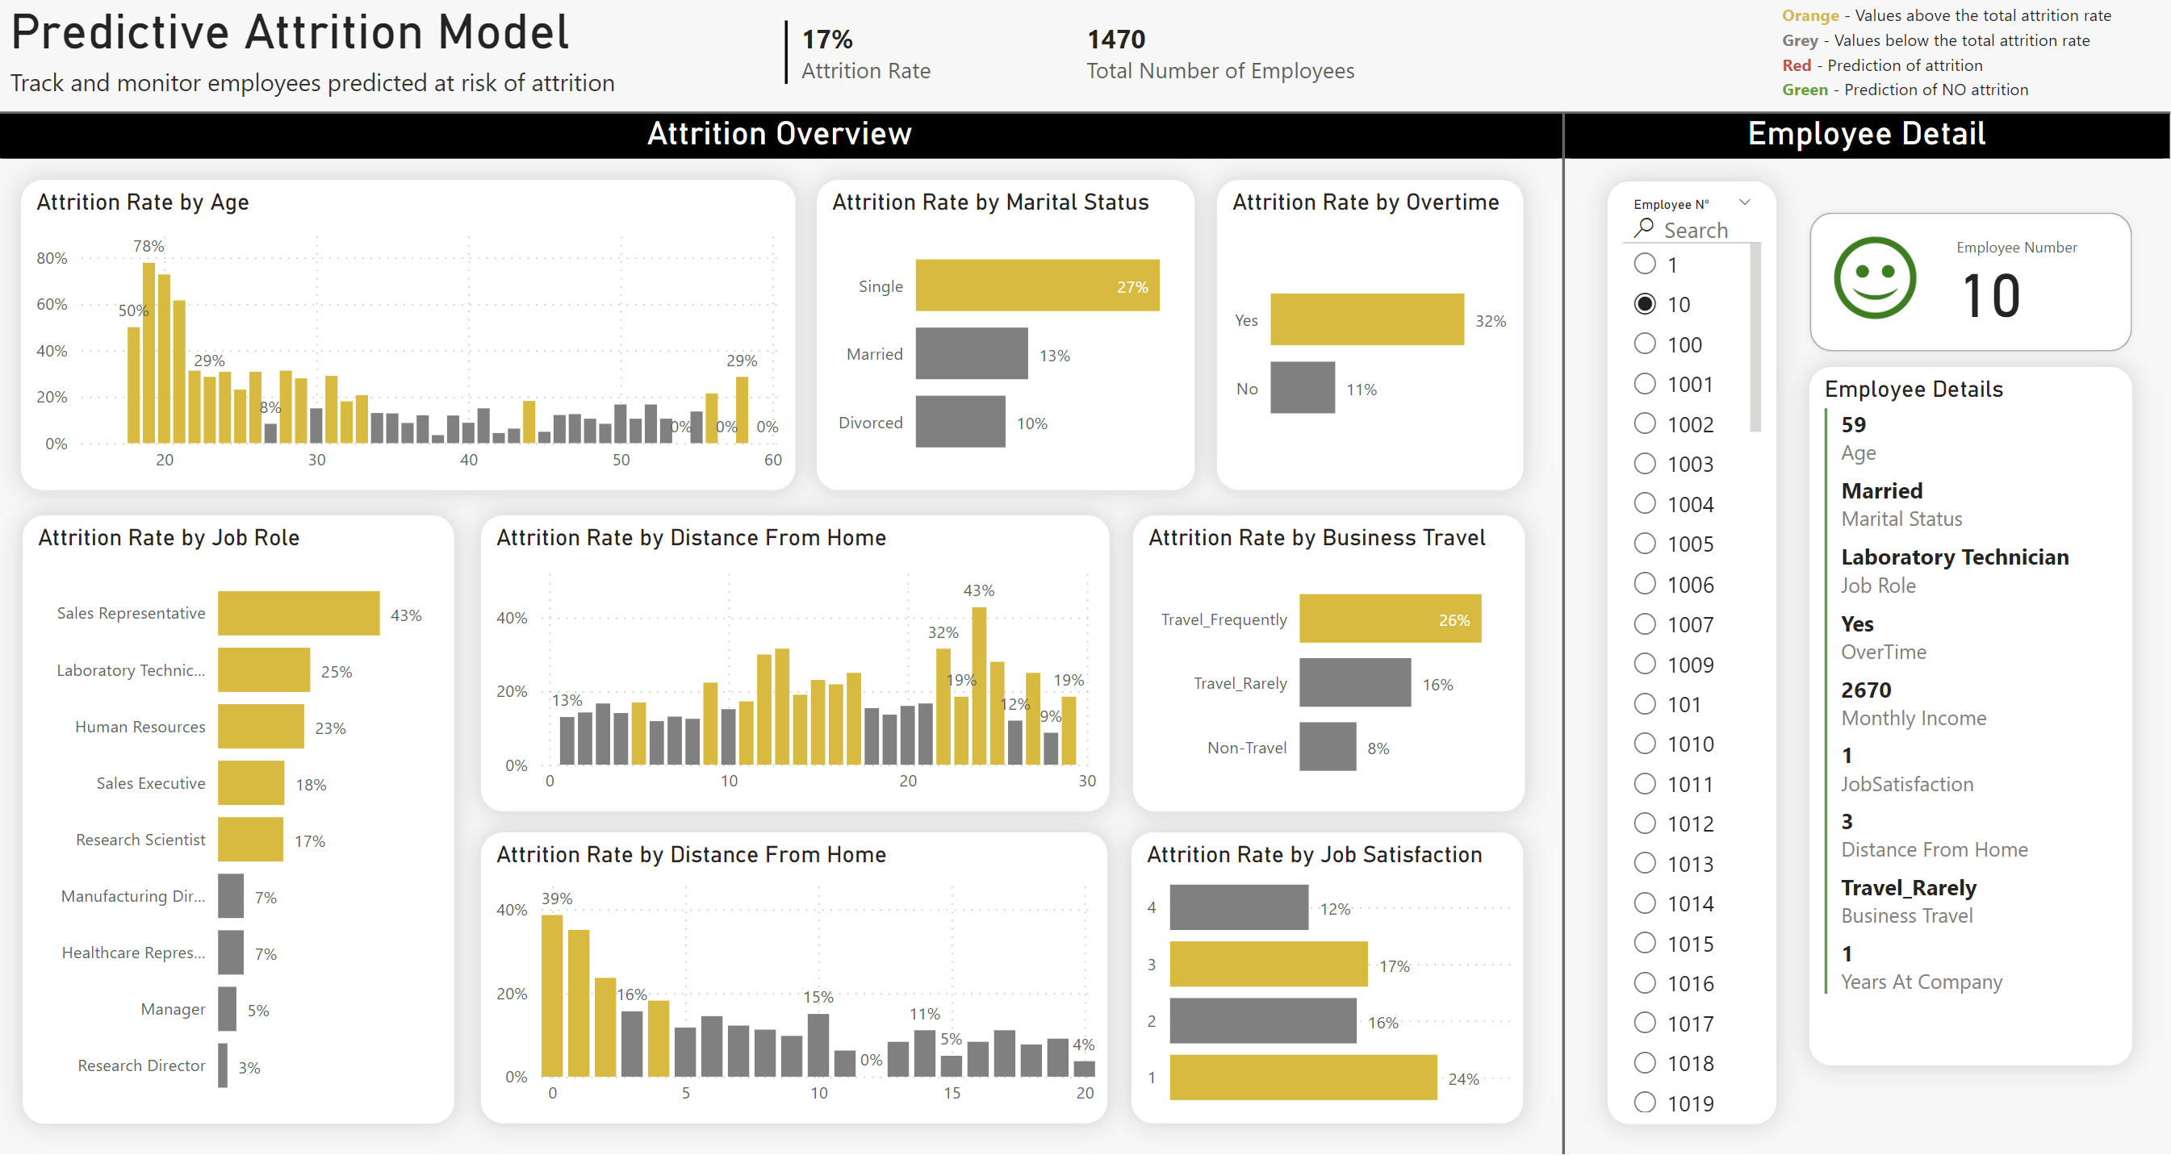
Integrating Predictive Attrition Model into HR Dashboard (Explained)
Attrition Overview: For the most important features, in orange is identified where the attrition rate are higher than the overall attrition rate of the company (17%)
Employee Details: According to the predictive model:
- If Red the employee is in risk of attrition
- If Green the employee is not in risk of attrition

